Slide 1
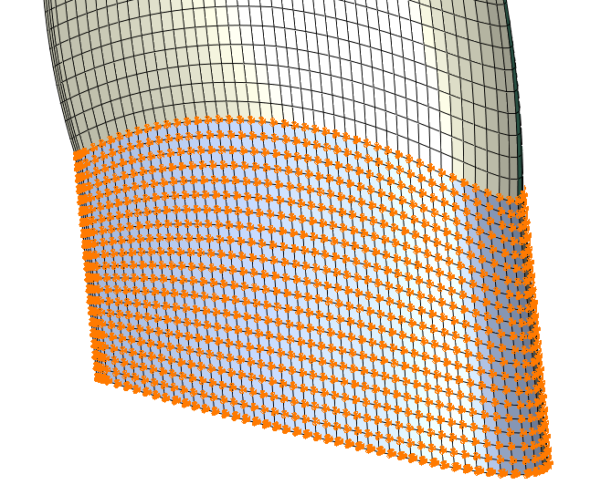
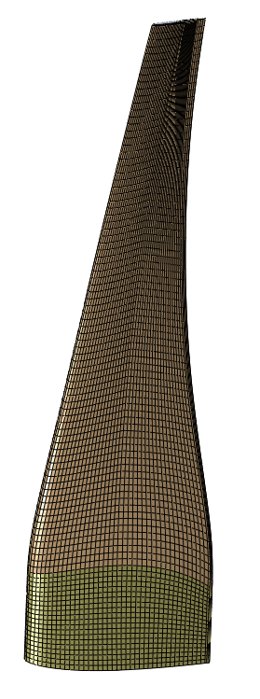
Initial FE Model
Single blade modeled
Full scale
Elements: 79,200
76,800 brick elements (C3D8I)
2,400 wedge elements (C3D6)
Composite material parameters
Elements for structural plies with outer surface material orientations
Elements for core plies with mid-surface material orientations
Smeared material properties used (estimated):
All tang exterior nodes fixed

Slide 2
Initial FEA: single full scale blade, “steady” CFD analysis

Slide 3
Interpolated FE data
 | Steady – Speed (m/s) |  |  |  |  |  | 3 m/s unsteady – time step |  |  | 2.0 and 2.6 unsteady
 | 2 | 2.2 | 2.4 | 2.6 | 2.8 | 3 | 3856 | 3870 | 3876 | 3146 | 4950
Fx | -2,679 | -3,073 | -3,469 | -3,876 | -4,273 | -4,666 | -5,550 | -5,538 | -5,526 | -3,298 | -4,671
Fy | 108 | 129 | 154 | 181 | 212 | 247 | 404 | 406 | 404 | 174 | 300
Fz | 484 | 623 | 784 | 961 | 1,162 | 1,382 | 1,969 | 1,979 | 1,983 | 704 | 1,401
Ftotal | 2,724 | 3,138 | 3,560 | 3,998 | 4,433 | 4,873 | 5,903 | 5,895 | 5,885 | 3,377 | 4,885
Mx | -27,892 | -35,985 | -45,222 | -55,436 | -66,882 | -79,381 | -112,620 | -113,125 | -113,310 | -41,116 | -80,893
My | -6,768 | -7,132 | -7,439 | -7,740 | -7,939 | -8,070 | -8,056 | -8,027 | -7,998 | -7,446 | -7,988
Mz | -177,679 | -202,637 | -227,558 | -253,018 | -277,543 | -301,607 | -354,857 | -354,174 | -353,322 | -218,404 | -302,941
Mtotal | 179,982 | 205,931 | 232,127 | 259,136 | 285,598 | 311,982 | 372,386 | 371,889 | 371,133 | 222,366 | 313,657
max disp | 2.783 | 3.153 | 3.523 | 3.903 | 4.268 | 4.624 | 5.433 | 5.425 | 5.411 | 3.448 | 4.697
max strain* | 1,593 | 1,798 | 2,001 | 2,208 | 2,405 | 2,595 | 3,017 | 3,011 | 3,002 | 1,968 | 2,638
min strain* | -1,800 | -2,034 | -2,268 | -2,506 | -2,734 | -2,955 | -3,452 | -3,446 | -3,436 | -2,230 | -3,007
*away from root
TDC

Slide 4
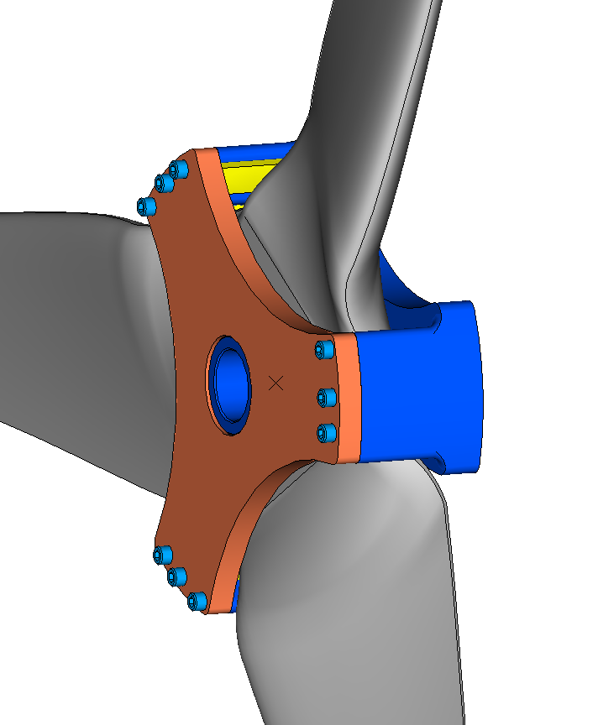
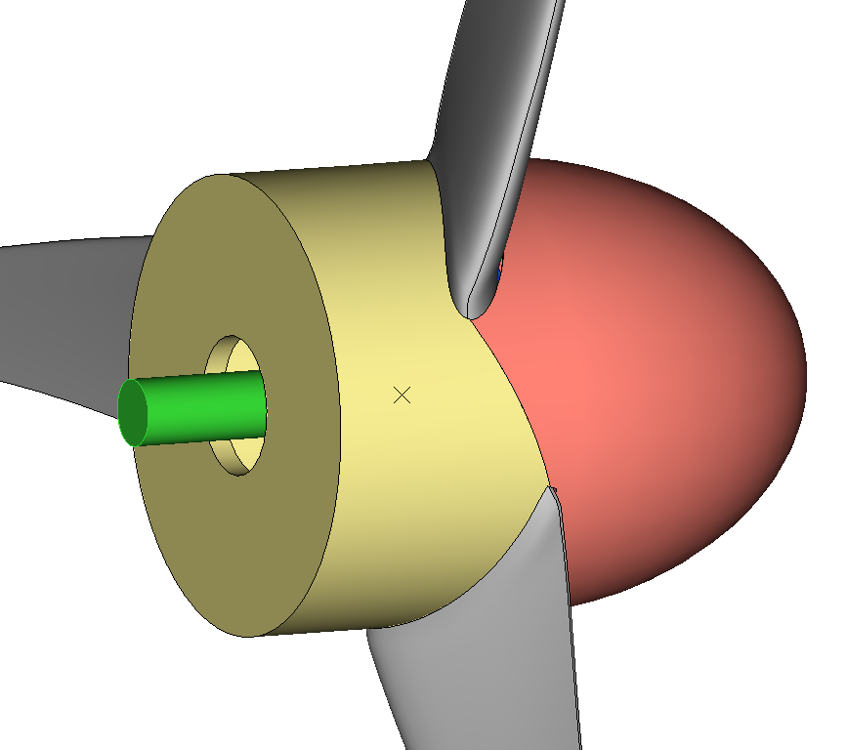
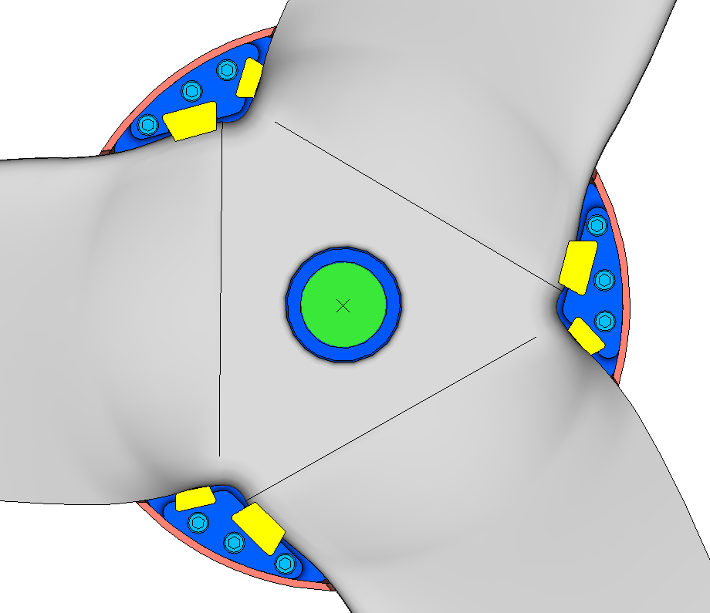
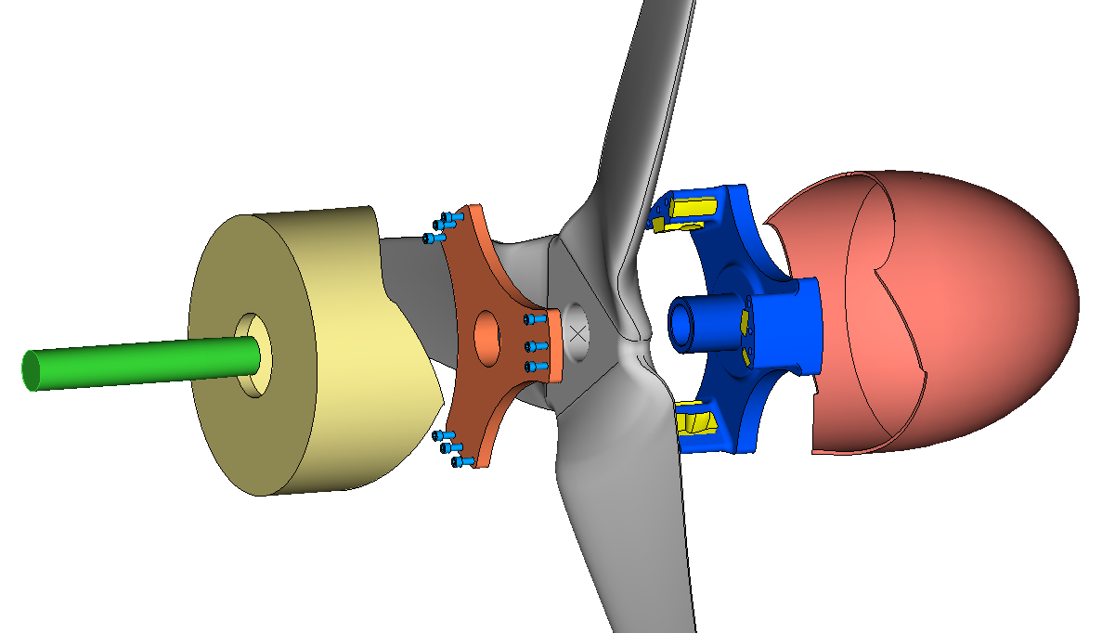
1-piece rotor assembly
Hub with tapered bore
Fairing (GRP)
Tail cone (GRP)
Bracket
Main shaft

Slide 5
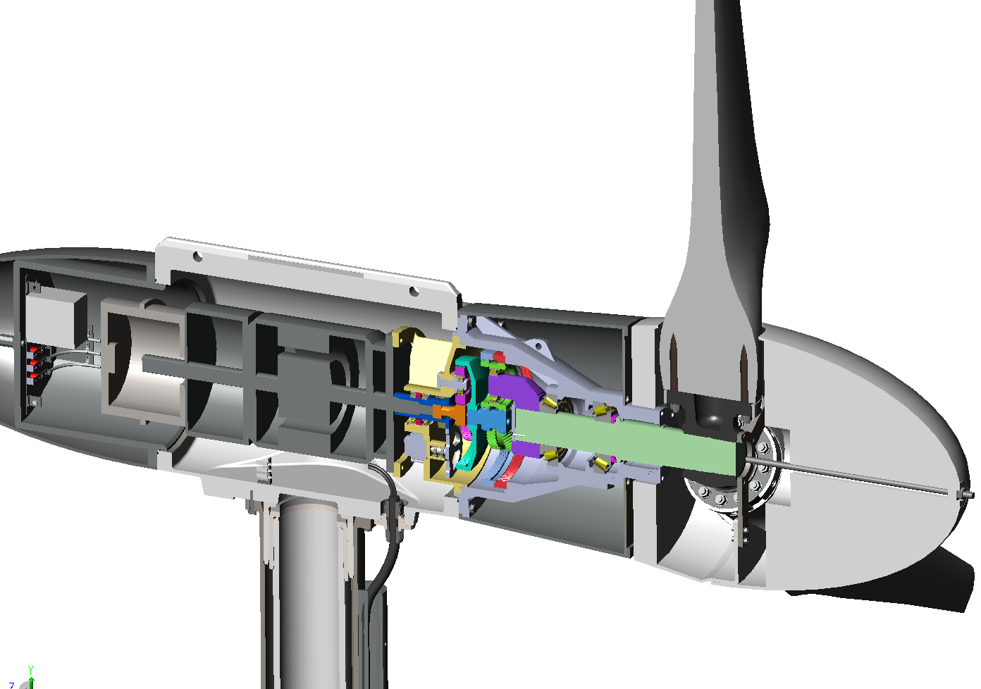
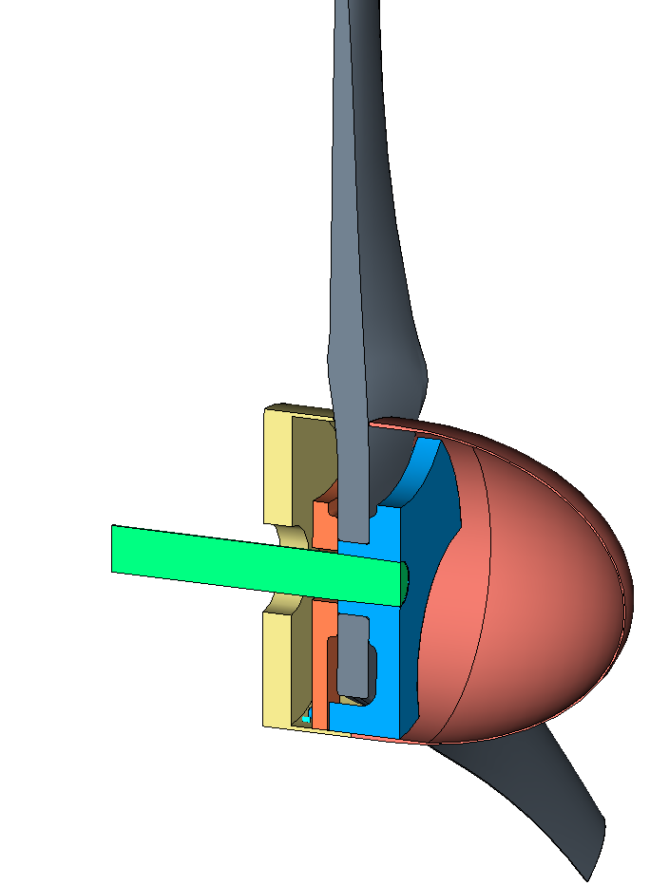
Current design
1-piece rotor

Slide 6
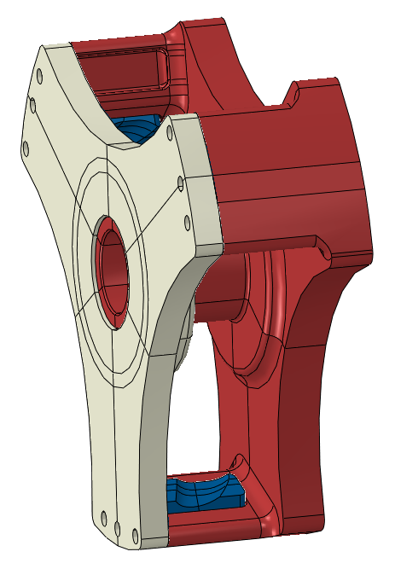
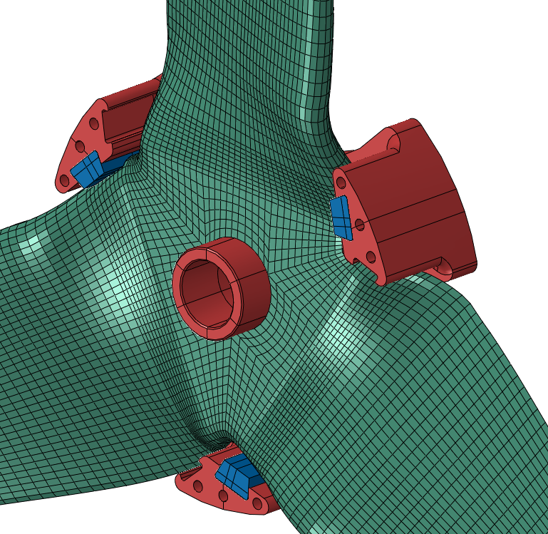
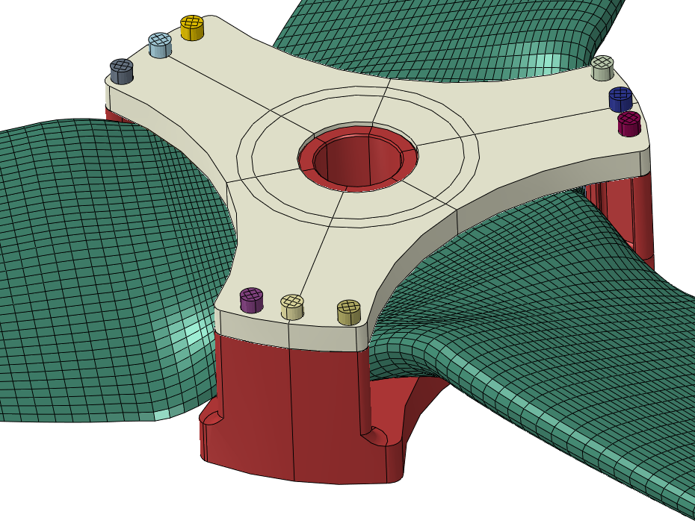
Rotor FE Model Assembly
Screws used to attach bracket to hub
Socket head cap screws, 1 inch diameter by 3 inches long
Screw head tied to bracket
Screw threads tied to hub
Preload force of 15,000 lbs. per screw specified in first step
Typical value for Grade 2 screws (stainless hardware)
Clearance specified between bracket and hub to preload the rotor
Set at 0.015 inch
Radial clearance between:
hub tube and rotor bore: 0.02 inch
Hub tube and bracket bore: 0.01 inch
Loading on rotor:
1 blade at TDC pressures, 2 blades at BDC pressures
2 blades at TDC pressures, 1 blade at BDC pressures
Hub tube inner surface fully restrained
All friction coefficients: 0.15
2.6 m/s unsteady pressures applied to blade
Materials:
Ductile iron
Steel
Rubber (E = 2.5 ksi, lower bound, nu = 0.48)
Composite material (measured):
Blade contact with these raised surfaces
Clearance: 0.015 inch

Slide 7
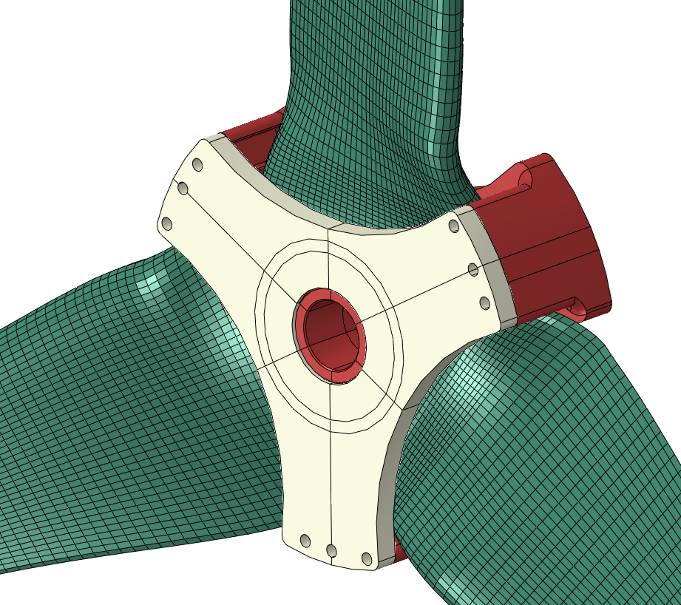
Rotor FE Model Assembly
Tied contact
Bracket contact with hub at screw locations
Blade contact with bracket and hub raised surfaces
Blade contact with LE rubber
E_{rubber} = 2.5 ksi
Lower bound
nu_{rubber} = 0.48
Hub pocket contact with LE rubber
Blade bore contact with hub tube
Line-to-line fit
Bracket bore contact with hub tube
0.01 inch radial clearance
Bracket contact with end face of LE rubber
All friction coefficients = 0.15
Hub bore fully restrained
2.6 m/s unsteady pressures applied to blade
Blade contact with these raised surfaces

Slide 8
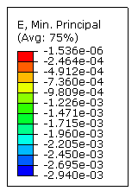
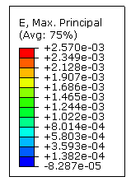
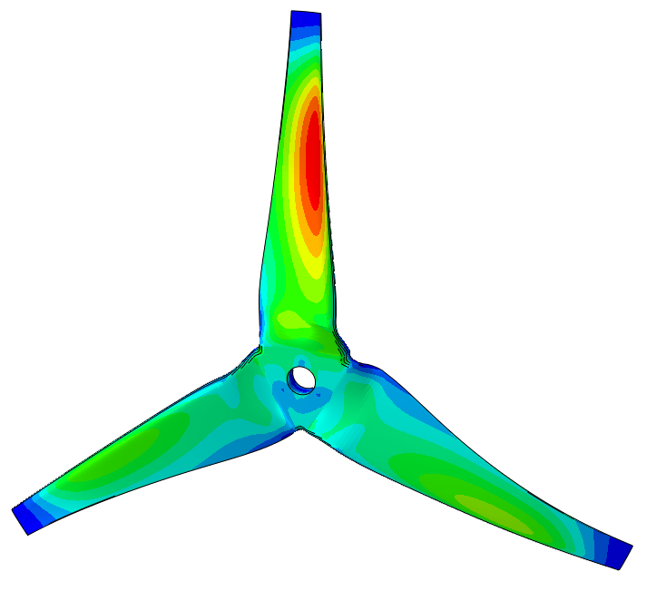
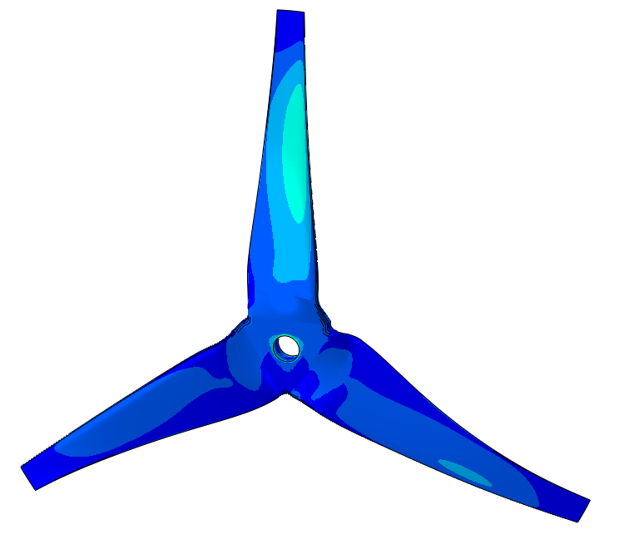
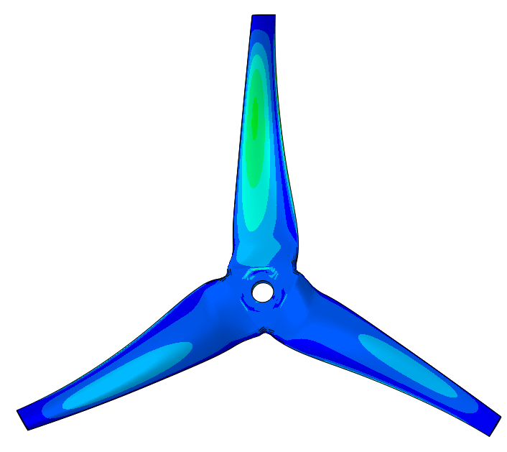
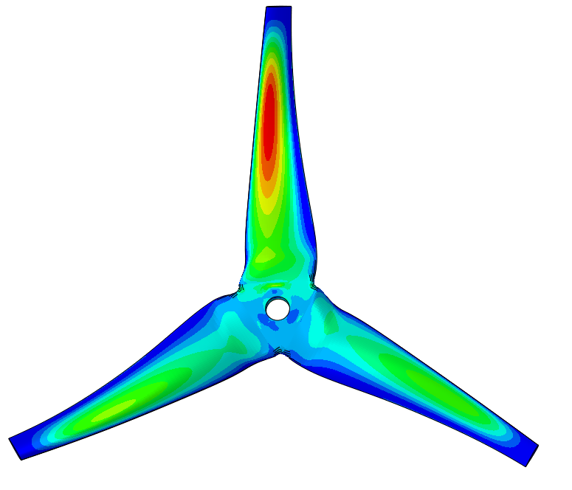
Principal strains in rotor
Max principal
Min principal
3,570 με
Suction side
Pressure side
Pressure side
Suction side

Slide 9
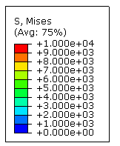
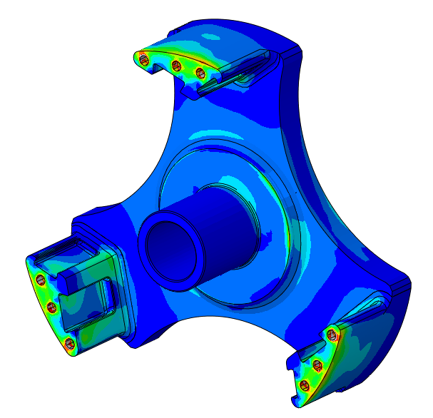
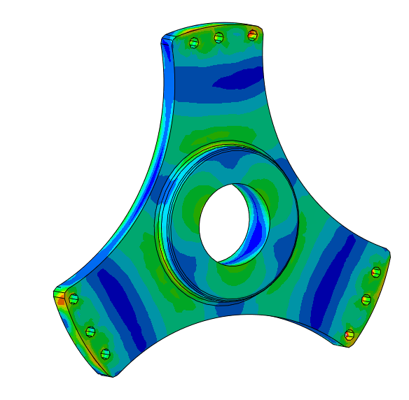
Stresses in hub and bracket

